Slide 1

Identità Digitale e Pagamenti: il nuovo equilibrio europeo nell’era di eIDAS 2
Matteo Panfilo
Product Strategy Director

Slide 2
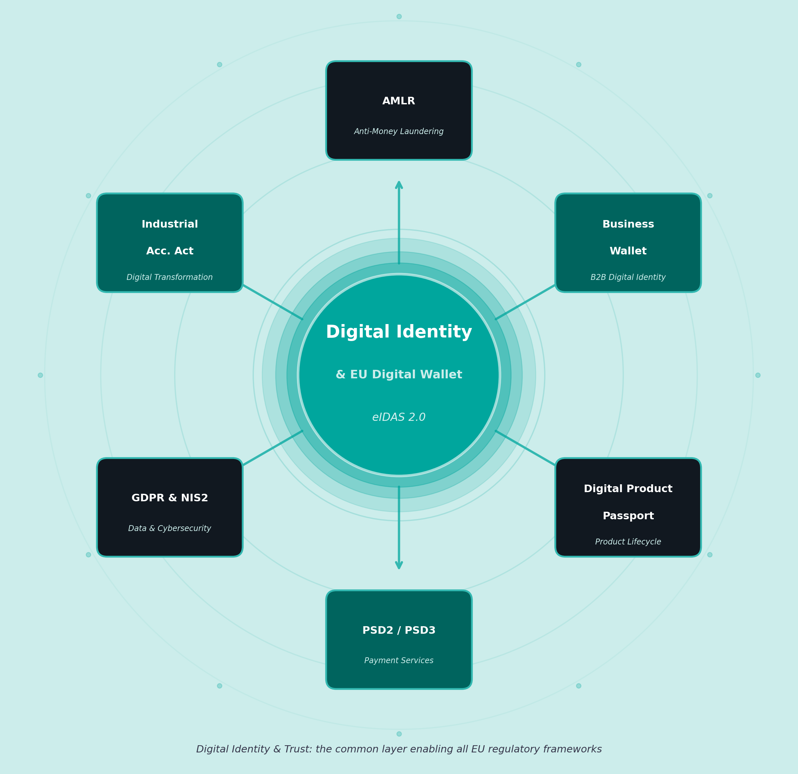

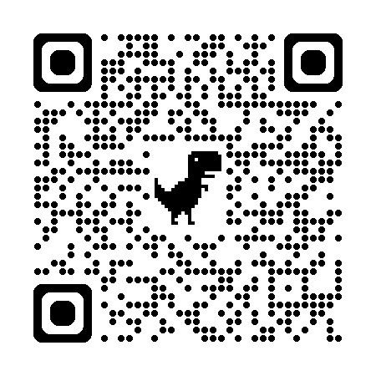

Digital
Identity
& EU Digital Wallet
The backbone of Europe’s Digital Strategy
eIDAS 2.0 creates a unified trust layer connecting multiple EU regulatory frameworks — from AML compliance to industrial digitalization and payments.
AMLR : PSR : Business Wallet : Ind. Acceleration Act : Digital Product Passport
Sandbox

Slide 3
2027: All Roads Converge Here
Four frameworks. One critical year. Your move.
2024/2025
2026/2027
2028/2030
Financial Regulations
AMLR
CDD RTS
AMLR Art 22 applicable
PSD3 full application
Digital EURO?
ViDA
mandatory
AMLR
PSR/PSD3
Q2 2024
Q2 2025
6/26
7/27
Q4 2027
2029
2030
12/26
8/27
Accessibility
mandatory
12/2027
eIDAS 2
5/26
Business wallet and eIDAS revision
eIDAS
Art 24
LoA Sub impact
Art 24
New KYC for QES with ETSI v2.1.1
43 months
Member States need to notify Bruxelles at least one EUDIW
Art 5f
Mandatory wallet KYC for regulated entities
today
Cross:
AI Act
DORA
NIS2
CRA
GDPR 2.0
Past
Future
Expected

Slide 4
Why a bank should move and how
1
2
3
4
Experimenting
Onboarding & login
(Wallet gateway)
Wallet provider
(Wallet application)
Attribute Issuer
(Q)EAA infrastructure
QES integration
(QES issued thru wallet authentication)
Payment integration
(pay with the wallet – depending from PSD3/PSR)
Platform
Integrate the wallets into the KYC and KYB processes
Become a Wallet Provider
Issue attributes
Sign with the wallet
Pay with the wallet, account to account
What
Why
Main
drivers
Mandatory request. Flexibility will be critical
Security, cost saving & higher conversion rate
Higher user app usage and stickiness
New revenues
Better UX for prospect and higher conversion rates
Potential new revenue fees and use cases
Defensive and innovation positioning
Revenues and partner network building
Better UX & cost saving
Better UX & revenues

Slide 5
Where Laws Shake Hands: AMLR Art 22 Meets eIDAS – waiting new CDD RTS..
(a)
Document-Based Verification
Art. 22(6)(a) AMLR
(b)
Electronic Means (eIDAS)
Reg. EU 910/2014 · Art. 22(6)(b) AMLR
Obliged entities shall verify customer identity through:
Submission of an identity document, passport or equivalent — and acquisition of information from reliable and independent sources, whether accessed directly or provided by the customer.
Key implication for Namirial:
Remote onboarding solutions must comply with biometric verification standards and produce auditable evidence chains.
Electronic identification means meeting eIDAS requirements:
Use of electronic identification means compliant with Regulation (EU) 910/2014, covering assurance levels 'Substantial' or 'High', plus relevant qualified trust services.
Key implication for Namirial:
eIDAS-certified solutions (eIDs, EUDI wallets, QES) provide the highest legal certainty for AML compliance — and are Namirial's core competency.
Biometric Identification
Remote Onboarding
eIDs
EUDI Wallets
QES

Slide 6




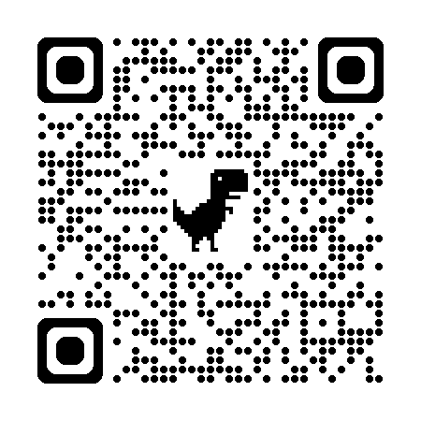

The Window Opens: Turn Compliance Into Competitive Edge
Dec 2026
eIDAS
eWallet in all EU
July 2027
AMLR
Art 22 + RTS
New KYC Applicability
Dec 2027
eIDAS
Art. 5f Mandatory for regulated entities
One clear message:
Review the KYC process!
Oh n. 1,
we have a wallet!
Oh n. 2,
we can accept wallet, eID or QES!
Oh n.3,
we must accept the wallet!

Slide 7
The Wallet Revolution: Real Value at Scale
01
European Scale, step by step
02
Speed & User Experience
FROM: 27 fragmented national identity systems
→ ONE EU-wide trusted digital identity framework
Financial institutions expand cross-border with a single onboarding process, reaching 450M+ EU citizens and reducing compliance costs.
FROM: 10+ minutes of manual KYC verification
→ Under 10 seconds automatic confirmation
Frictionless digital onboarding eliminates document submission and manual review. Faster time-to-serve means lower abandonment and higher conversion rates.
03
Verified Attributes
04
Flywheel Effect & New Use Cases
FROM: Physical documents, manual checks, step-by-step verification
→ Instant verified attribute delivery on demand
Education, employment, address, health records — all cryptographically verified. Businesses receive only what they need, reducing liability and GDPR exposure.
FROM: One-time compliance event per customer
→ Continuous recurring wallet interactions
Every new use case — authentication, payments, contract signing — drives further wallet adoption. Network effects create a self-reinforcing digital ecosystem.

