Slide 1
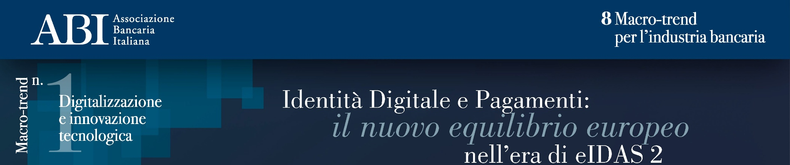
EUDIW Wallet e Large Scale Pilot europei: risultati, obiettivi e prospettive
Romano Stasi, Segretario Generale ABI Lab
Intervengono:
Ludovica Baccilieri, Innovation Associate Bancomat
Filippo Chiricozzi, Innovation & Digital Assets Banca Sella
Leone Riello, Innovation Engineer Tinexta Infocert

Slide 2












Cronologia dei Large Scale Pilot
2023 | 2024 | 2025 | 2026 | 2027
01/07/2023
20/05/2024
Second half 2025
End of 2026
End of 2027
Start of the first round of Large Scale Pilots projects to support the implementation of the European Digital Identity Framework
Publication of the eIDAS 2 Regulation
Start of the second round of LSPs
Obligation for Member States to offer a wallet
Obligation to recognize the wallet
Large Scale Pilots (LSPs)
Regulatory milestones
4 Large Scale Pilots
2 Large Scale Pilots
EUDI Wallet User centric
Educational and social security use cases.
Wallet for Travel : Digital Travel Credential; Tickets & check-in; mVRC.
Wallet for Payment : SCA; Payment initiation.
SIM eRegistration; Bank account opening; eDriving License; eGov Service; eSignature / ePrescription.
Business Wallet
Travel use cases, focusing on payment journey and organizational digital identities.
Supply Chain: Authentication & access; utomated exchange & Digital Product Passport; Public procurement; E-invoicing…
Wallet for Payment: Account opening; Consumer & corporate payments.
Wallet for Business: KYC/KYB; Company branch creation; Micro-credentials; OOTS access.
Payment use cases and use of eDriving licence.

Slide 3














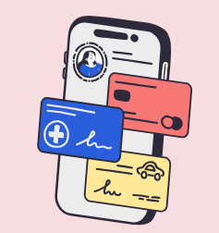


Aptitude: Pan-European digital identity collaboration
12
117
29
Countries represented
Public and private partners
Observers
Entity external to the Consortium with a recognized advisory role in the project. Observers are expected to contribute with their expertise or strategic insight on key topics addressed throughout the project’s activities.
FR
CZ
DE
EL
Ministries, state operators, research centres, major companies and start-ups acting as wallet issuers, credential issuers, and relying parties
HU
IT
LT
LV
NL
PL
PT
UA
Diverse and comprehensive testing environment for the European Digital Identity Wallet (EUDIW), including all eIDAS roles:
28 public administrations
Cross-border cooperation and shared insights, vital for the wallet's pan-European implementation.
Wallet providers
Service providers
87 private sector partners
Issuers

Slide 4





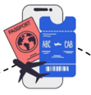
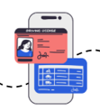
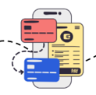









4 use cases su mobilità e pagamenti
Digital Travel Credentials (DTC)
Tickets and Check-in
mVRC
SCA and payments
Manage the issuance and revocation of DTCs via the EUDI Wallet in coordination with national issuing authorities and national printers for use cases related to border control.
Simplify the traveler journey for tickets and check-in at hotels, transportation (air, rail, road, maritime), and tourist sites. Integrate student cards to benefit from dedicated fares.
Pilot the use of the mobile Vehicle Registration Certificate (mVRC) to demonstrate its ability to be shared among multiple drivers, whether for personal vehicles, rentals, or shared mobility solutions.
Enhance the wallet to integrate banking and payment functionalities: secure online transactions through payment and strong customer authentication (SCA).
Participation of member-states
Forte attenzione ad utilizzare un approccio comune e allineato
nell’integrazione delle soluzioni di SCA per i pagamenti

Slide 5
WEBUILD: Struttura del Consorzio
WP1: Project management and coordination
WP lead: KVK, - NL
General Assembly
Management Board
Project Management
Review Board including legal matters
Lead: MIN.EZ. - NL
Lead: MIN.EZ. - NL
Lead: KVK - NL
Lead: Schluss - NL
Code | Name
BU1 | KYS/KYC/KYB/DD
BU2 | Create Company Branch
BU3 | Foreign Tax Declaration
BU4 | Company representative acting on behalf of company
BU5 | Issue Micro credentials
BU6 | Business Access to One Only Technical System
SC1 | Authentification & access for transport
SC2 | Trusted Data Sharing for Data Spaces
SC5 | eInvoicing
PA1 | Consumer Banking
PA2 | Consumer Payments
PA3 | Corporate Banking
PA4 | Corporate Payments
WP2: Wallet for Business
WP3: Wallet for Payments
WP lead: ICTU - NL
WP lead: ICTU - NL
WP5: Forums
Domain Business
Domain Supply chain
Domain Payments
WP6:
Communication
& Dissemination
WP lead:
BOLAGSVERKET - SE
Domain lead: Infogreffe -FR
Domain lead: UPRC - GR
Domain lead: VISA
BU1
BU2
SC1
PA1
PA2
lead: Bundesanzeiger - DE
lead: BOLAGSVERKET - SE
lead: IN GROUPE - FR
lead:
GSISDG
GR
lead: Dutch Payment Association - NL
Ecosystems Forum (including domain specific)
BU3
BU4
SC2
lead: Tax Administration - NL
lead: REGISTRADORES - ES
lead: ILVO - BE
PA3
PA4
Forum lead:
IZERTIS - ES
lead:
Bundesanzeiger
DE
lead:
State Treasury
FI
BU5
BU6
SC5
WP lead:
INTESI GROUP - IT
Member States
Advisory Forum
lead: SUNET SE
lead: ICTU - NL
lead: OPEN PEPPOL - BE
Forum lead:
BMDS - DE
WP4: General capabilities
WP lead: DIGG - SE
Architecture group (including security)
Semantics Group
Trust registry infrastructure
QTSP (incl.
signatures)
PID + LPID providers
Wallet providers
Testing
group
Group lead:
DIGG - SE
Group lead:
Finnish Tax
Agency - FI
Group lead:
PDCM - IT
Group lead:
Cleverbase - NL
Group lead:
INFOGREFFE - FR
Group lead:
GRNET - GR
Group lead:
SIGNICAT - NO
WE BUILD Consortium: 30 countries represented, over 180 organizations involved, including 13 National Business Registers, Tax Authorities, Financial Institutions, Wallet Providers, ICT Companies & SMEs and Academic & Research Institutions.

Slide 6






WE BUILD Financial Services Group — Temi chiave
Marzo 2026
Integrazione Wallet
SCA e PSD2/PSR
Attestazioni KYC/KYB
Coordinamento tra EUDI Wallet personale ed EU Business Wallet (EBW): architetture distinte, ancora in evoluzione.
Le banche chiedono chiarezza su SCA via wallet. DG CONNECT : SUA = SCA. Rimane gap di allineamento EBA su responsabilità e delegazione.
Consumer: PID, Tax ID, indirizzo per onboarding persone fisiche.
Business: CompanyInfo, UBO list, EU Power of Attorney, LPID. Banche chiamate a validare i set.
QTSP e Root of Trust
IBAN come attestazione
Frode e AMLR
Dibattito aperto: QEAA da QTSP privato equivale a PID da Stato membro? Banche: no, la Trusted List non livella la natura della fonte. Manca Liability Framework.
Solo la banca che gestisce il conto è authentic source dell'IBAN. La banca non è solo relying party: è issuer. Analisi in corso sul lifecycle e la revoca.
Nuovi RTS AMLA richiedono analisi. Consultazione pubblica aperta fino all'8 maggio. WeBuild valuta una risposta coordinata.
Acronimi:
QEAA - Qualified Electronic Attestation of Attributes
QTSP - Qualified Trust Service Provider
LPID - Legal Person Identification Data
PID - Person Identification Data
UBO - Ultimate Beneficial Owner
Fonte: riunione inaugurale FS Group WE BUILD, 13 marzo 2026

Slide 7



Elementi discussione nella condivisione delle attestazioni
Architettura delle attestazioni
WE BUILD
AMLR Art. 22 — Tensione regolamentare
Posizione banche nei LSP: Preferenza per MS root of trust
Standard primario ✓
Catena di responsabilità
Verifica basata su documenti o dati provenienti da fonti affidabili e indipendenti — in primis registri governativi o fonti pubbliche autoritative. Il PID emesso dallo Stato membro soddisfa questo standard direttamente.
Con PID da Stato membro, la catena di liability è evidente ma non formalizzata. Con QTSP privato, la banca è tenuta a dimostrare la ragionevolezza dell'affidamento a un soggetto privato in caso di contestazione.
vs.
Refundability e disputabilità
Strumento ammissibile ≠ equivalente
In caso di account opening fraudolenta basata su QEAA errata o compromessa, la banca subisce il rischio operativo senza anchor pubblico. Il quadro di rimborso verso il cliente non è bilanciato da root of trust Stato-certificato.
Consente l'uso di mezzi di identificazione elettronica, incluse le QEAA, se conformi ai livelli di garanzia eIDAS 2. Ammissibile, ma non eleva la QEAA al rango di fonte autoritativa. Stare sulla Trusted List non equipara QTSP allo Stato membro.
Variabilità cross-border dei QTSP
Acronimi:
CDD - Customer Due Diligence
MS – Member state
QEAA - Qualified Electronic Attestation of Attributes
QTSP - Qualified Trust Service Provider
QTSP di paesi europei diversi possono avere differente affidabilità in termini di compliance operativa reale. Il costo di verifica caso per caso vanifica parte del beneficio di automazione del wallet.

